Slide 1
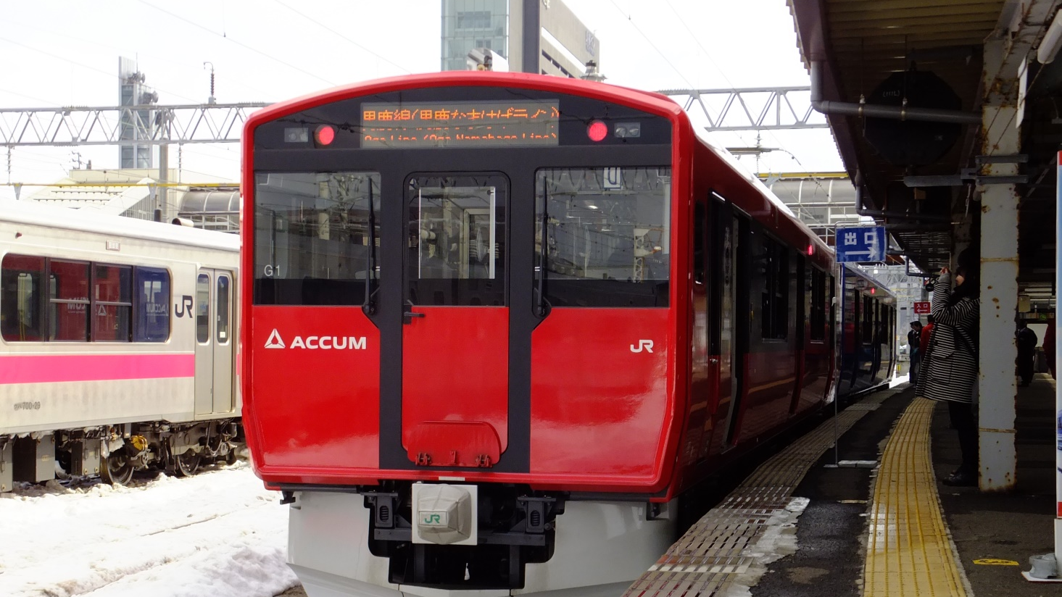
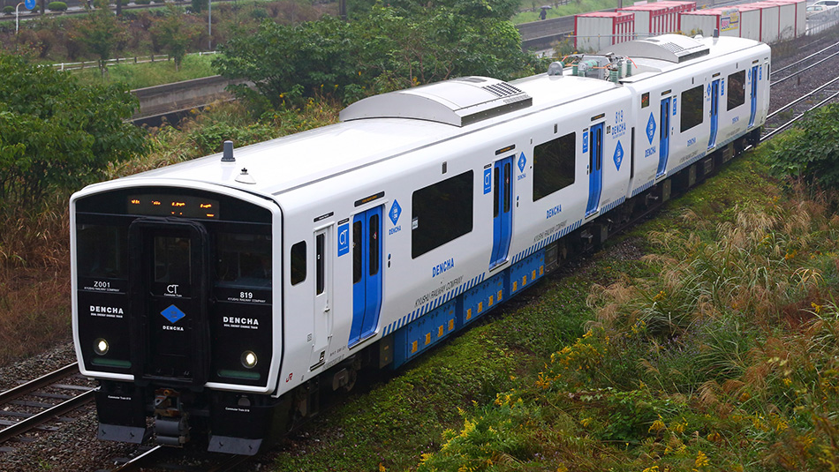
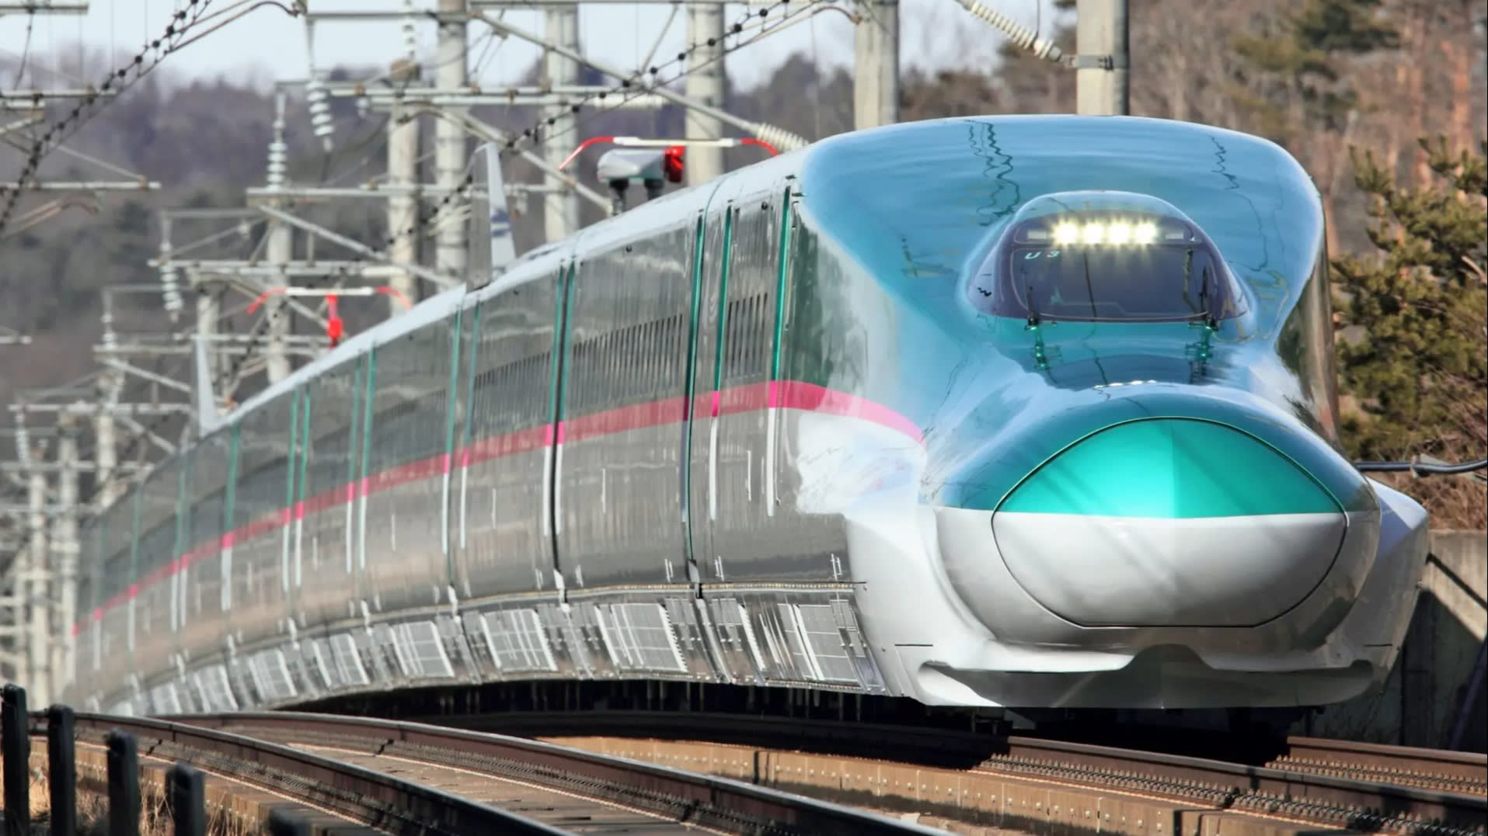
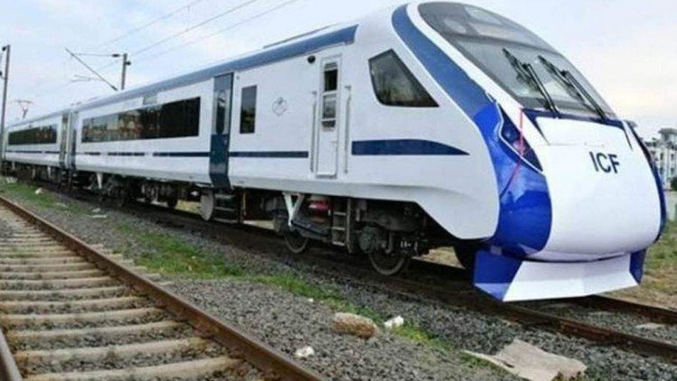
DPRS/TRAINSET
SIDDHARTH SHANKAR
P(Trainset)/IRIMEE

Slide 2
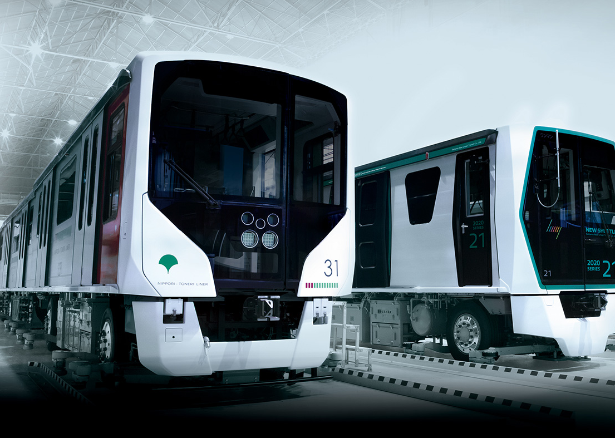
What is a DPRS ?

Slide 3
DPRS
Stands for Distributed Power Rolling Stock
Class of vehicles fit to move on Railway systems and one where the Propulsion systems and Powered wheels for providing tractive force are distributed over more than one and mostly large number of vehicles
This is opposed to locomotive hauled trains where the equipment and powered wheels producing Tractive effort are contained in vehicle/ vehicles which are non-passenger carrying and are coupled to passenger cars through mechanical coupling

Slide 4
Concentrated Power train
Locomotive
Coach
Coach
Coach
Coach
Coach
Coach
Coach
Coach
Coach
Distributed Power train
Motor coach
Coach
Coach
Motor coach
Coach
Coach
Motor coach
Coach
Coach

Slide 5
TYPES ON THE BASIS OF POWER SOURCE
Internal Power Source - Diesel Electric and Multiple Unit with AC-DC or AC- AC Drive or Hydraulic Drive.
External Power source - EMU/ MEMU Train sets drawing power from AC OHE with DC Motors or AC Motors OR DC OHE or third rail with AC Motors.
Hybrid – Combination of Internal and external power source

Slide 6
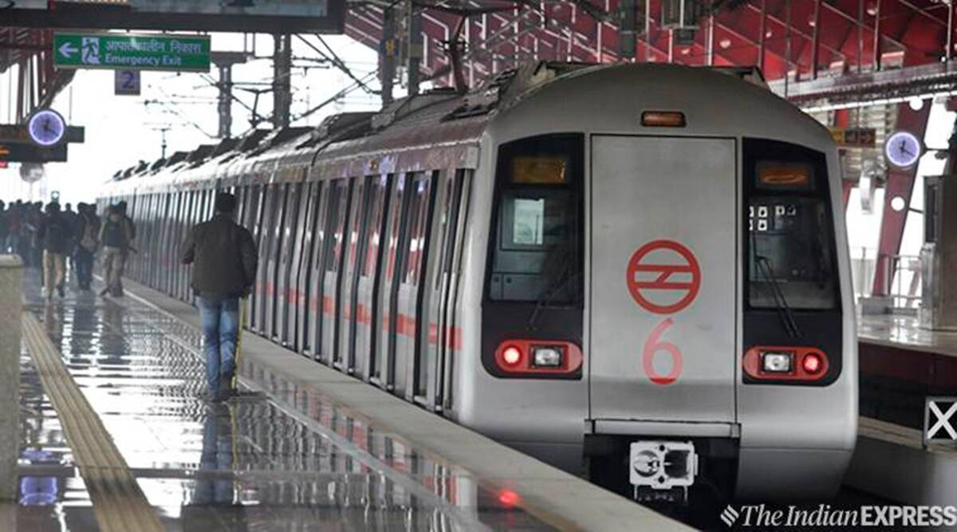
DELHI METRO

Slide 7
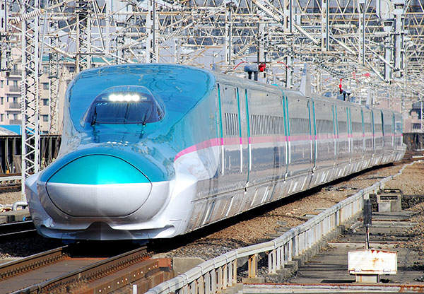
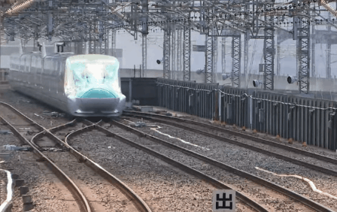
SHINKANSEN
100 % powered trainset
All axles in a bullet train are propelled by a traction motor

Slide 8
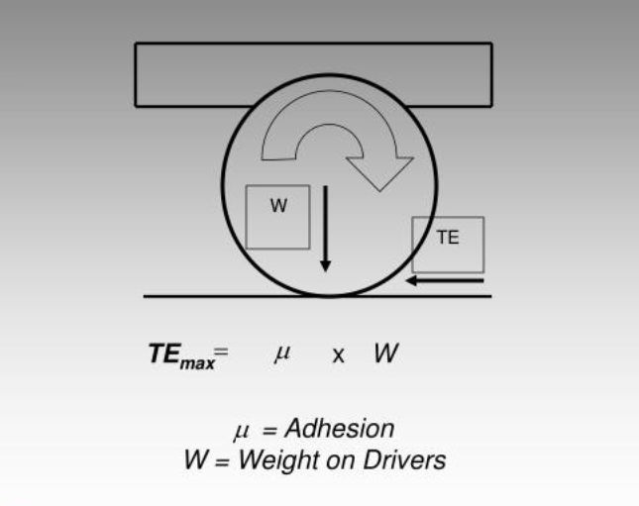
CONCEPT OF TRACTION

Slide 9
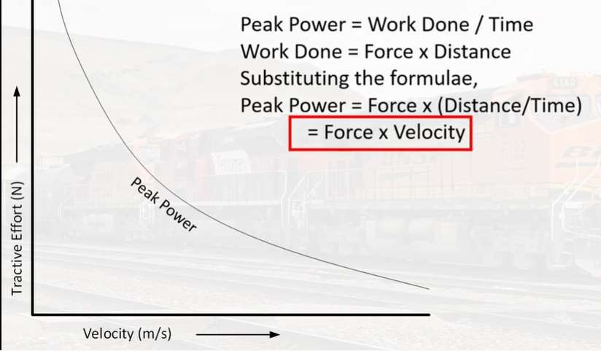
Peak Power Curve

Slide 10
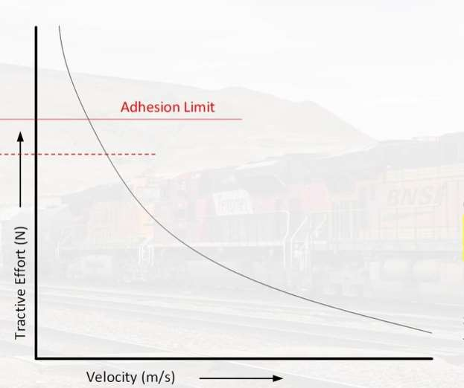
Adhesion Limit

Slide 11
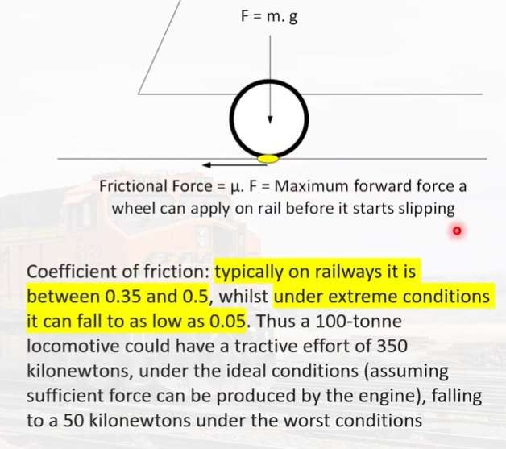
Why is there an Adhesion Limit?

Slide 12
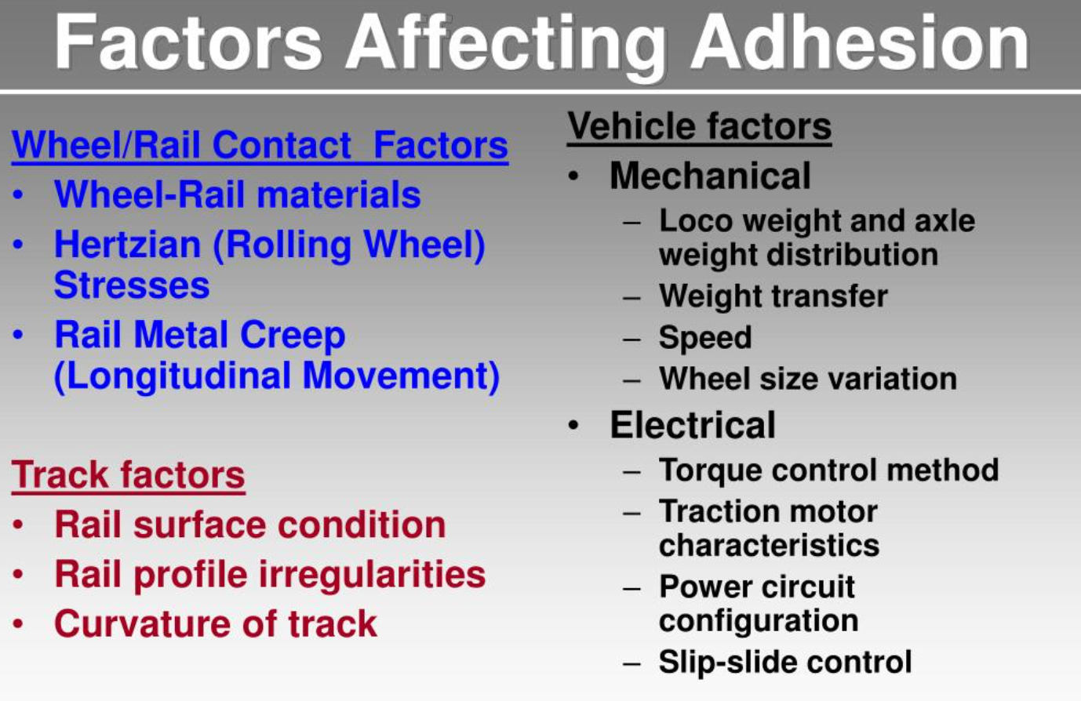

Slide 13
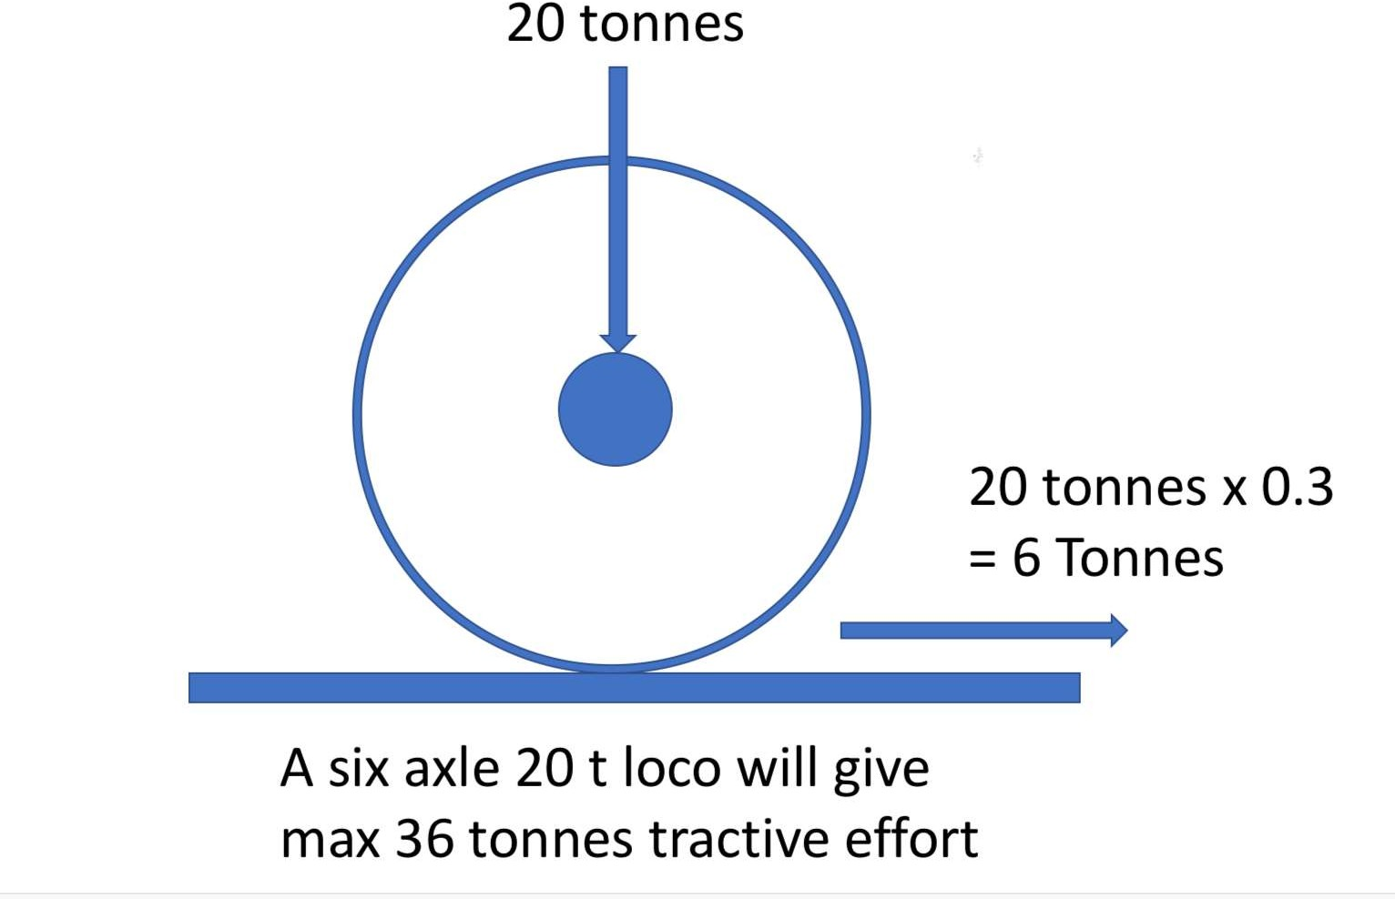
The Law of Rail Traction

Slide 14
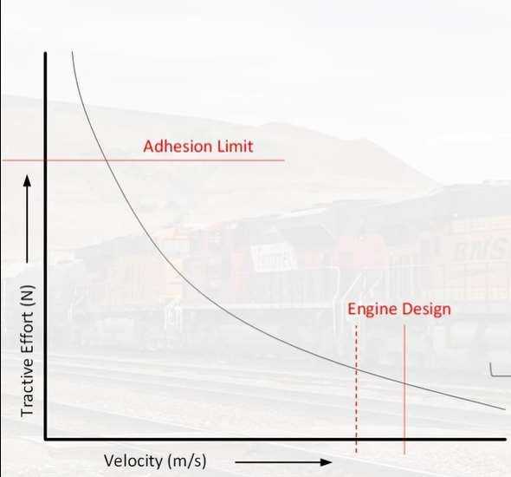
Speed Limit

Slide 15
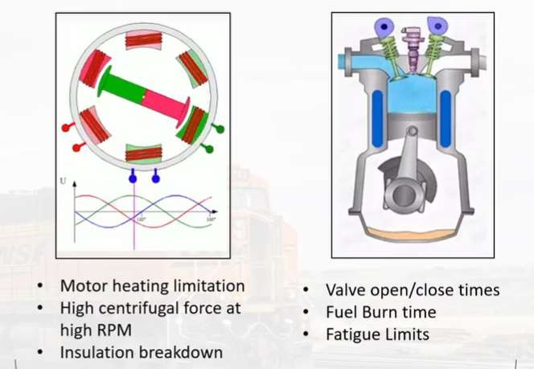
Why is there a Speed Limit?

Slide 16
Other Factors Limiting Maximum Speed
Bearing Design
Vibrations
Mechanical Transmission System
External - Tracks and Structures

Slide 17
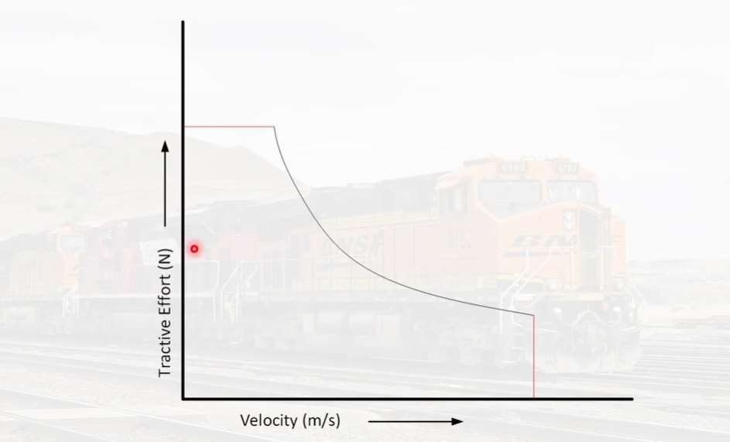
Tractive Effort of a Powered Rolling stock

Slide 18
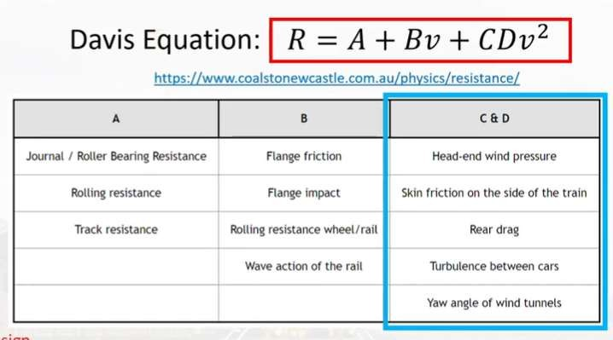
Resistance to Movement of Rolling Stock

Slide 19
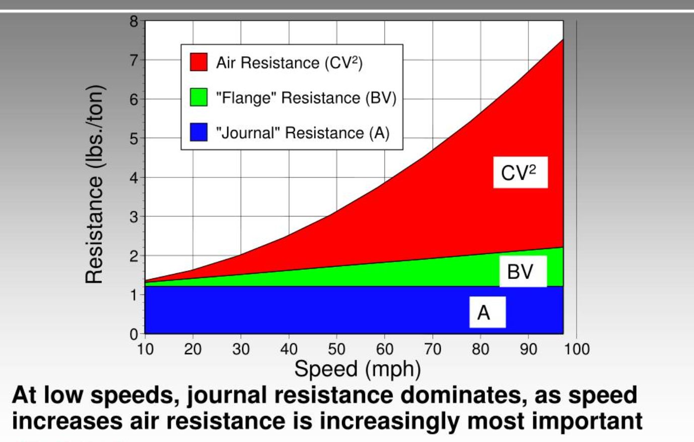

Slide 20
Aerodynamic drag of a typical train
Front
4.5%
Tail
3.5%
Surface friction from sides and roofs
27%
Under floor equipment
7.5%
Bogie and wheels
45.5%
Ventilation etc
4%
Pantographs
8%

Slide 21
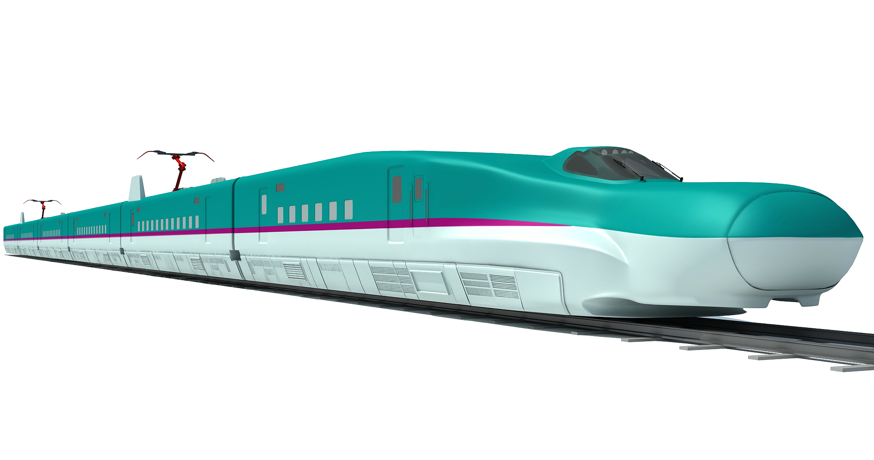

Slide 22
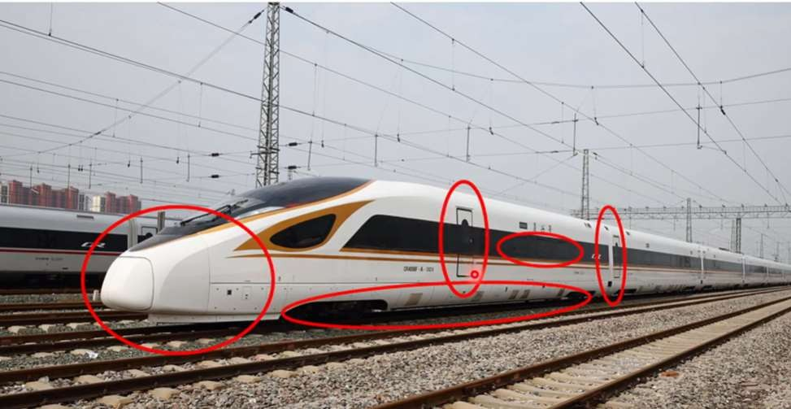
Vehicle Design to Minimise Air Drag

Slide 23
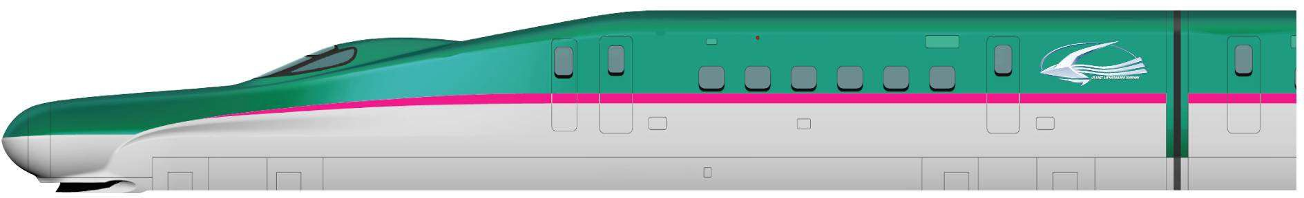
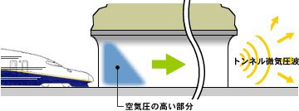
Achieving High Speed
Aerodynamic Design
For high speeds, air drag is to be minimized.
Aerodynamically designed Car body with long nose to reduce drag
When high speed train exits a tunnel, a blasting sound is generated due to micro pressure waves. To reduce this micro pressure, the front car is designed with a nose section.

Slide 24
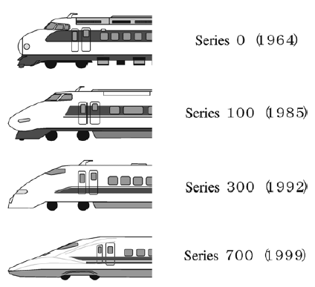
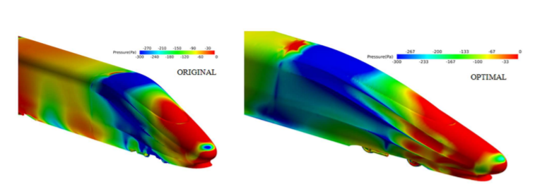
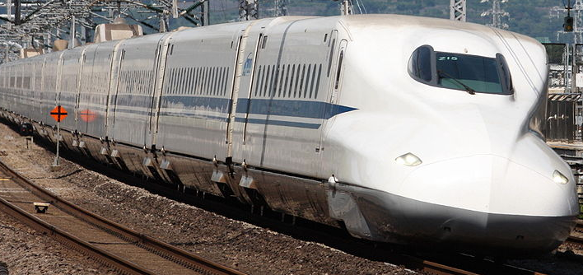
AERODYNAMIC BODY DESIGN

Slide 25
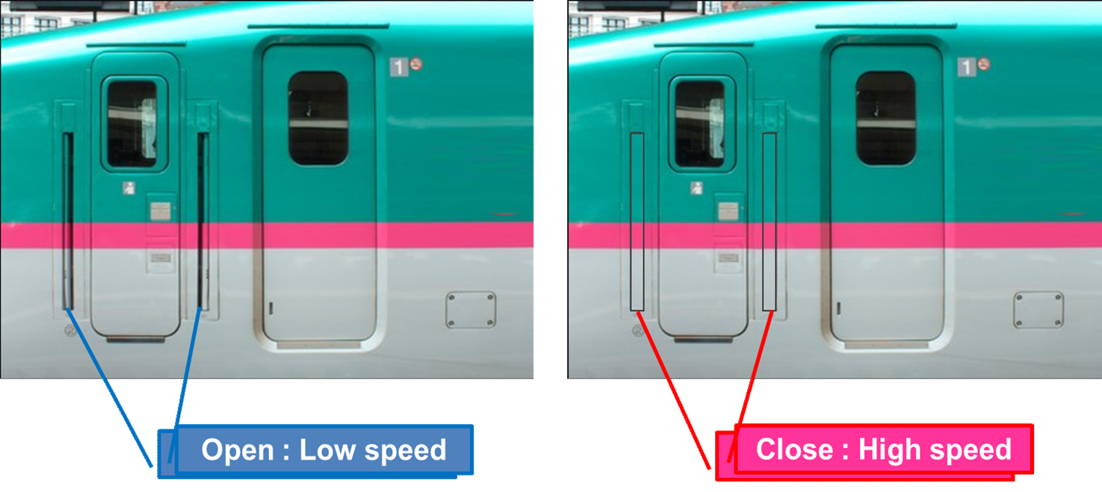
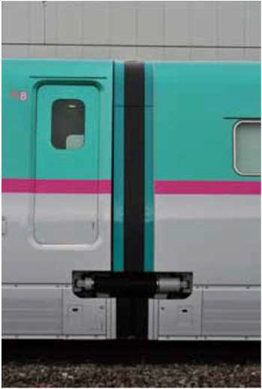
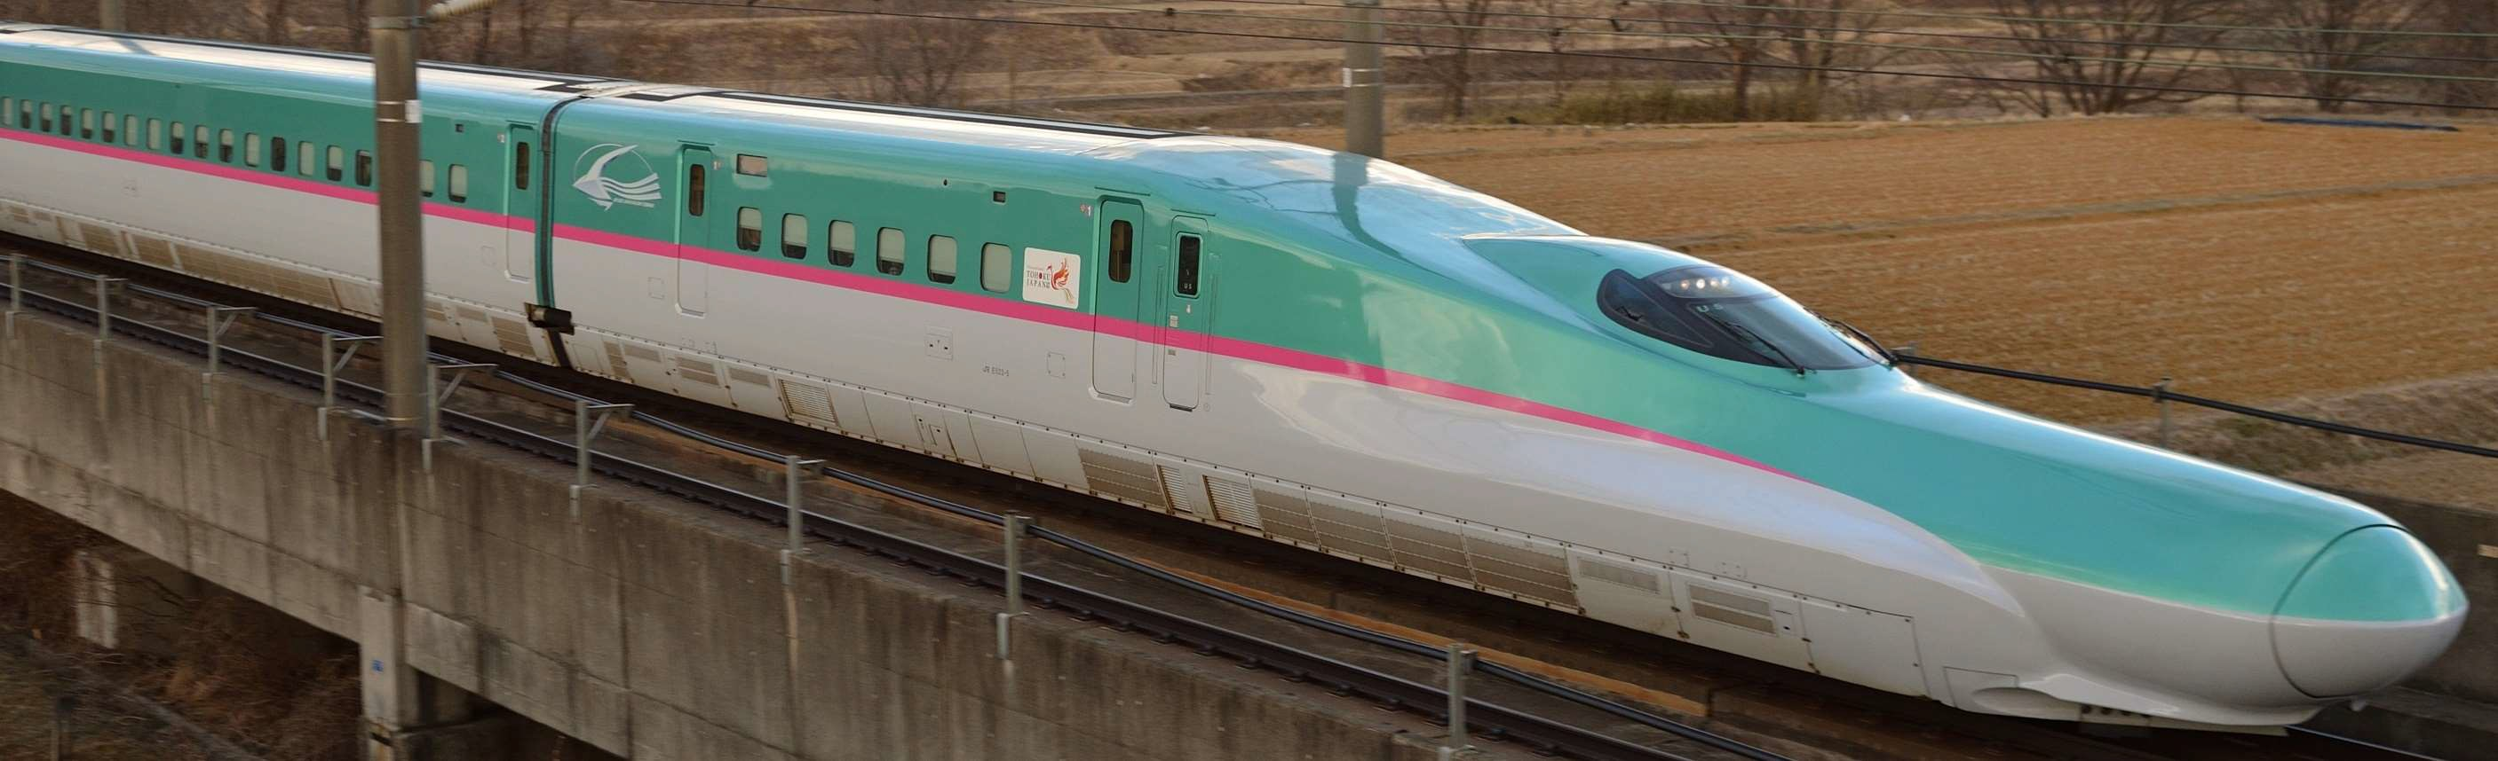
Achieving High Speed
Reducing Air Drag
Fairings fitted all around the gaps between cars
Side and Bottom covers for Bogies and other underframe mounted equipment

Slide 26
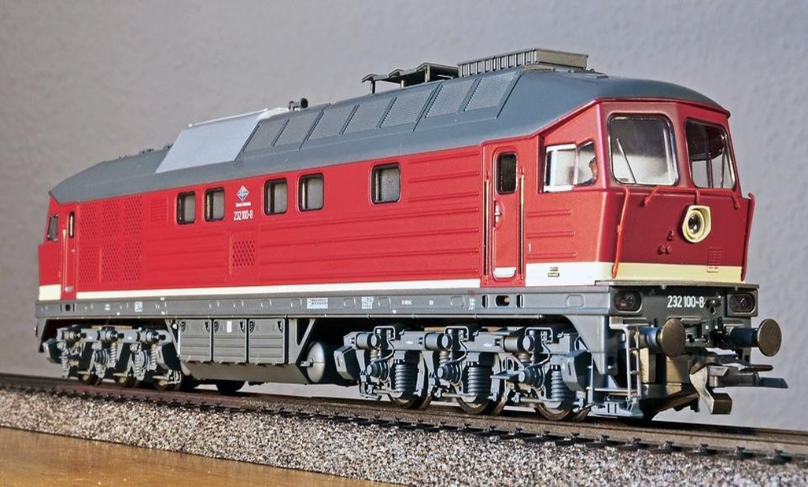
Why Distributed Power ?
6𝐹_{𝛼}- (D+𝑇_{𝑟} )= 𝑚_{𝑡𝑟} 𝑎_{𝑥}
6𝛼𝑃_{𝑖}- (D+𝑇_{𝑟} )= 𝑚_{𝑡𝑟} 𝑎_{𝑥}
𝑛𝛼𝑃_{𝑖}- (D+𝑇_{𝑟} )= 𝑚_{𝑡𝑟} 𝑎_{𝑥}
𝛼𝒏𝑷_{𝒊}- (D+𝑇_{𝑟} )= 𝑚_{𝑡𝑟} 𝑎_{𝑥}
More adhesive mass in case Of DPRS
n- number of powered axles 𝛼- adhesion coefficient 𝑃_{𝑖} – Axle load 𝐹_{𝛼} - adhesive mass
D – Rolling resistance, drag resistance etc 𝑇_{𝑟} - Trailing load
From above equation it is clear that greater is the number of powered axles, Greater is the adhesive mass and hence better acceleration

Slide 27
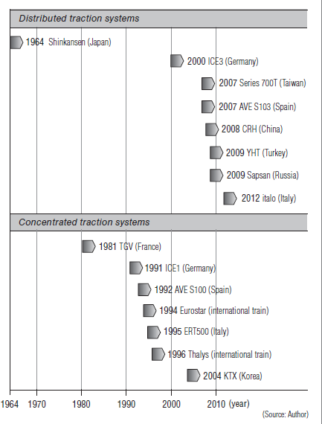
Distributed Power/Concentrated Power
The distributed traction system has many advantages
energy efficiency
light axle weight
high acceleration and deceleration due to large number of driving axles
more cabin space as there are no
locomotives
and ability to utilize the energy of regenerative braking efficiently
Ref: Akiyama et al.

Slide 28
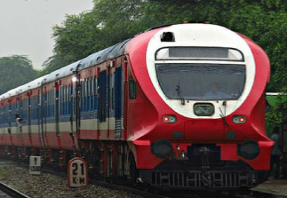
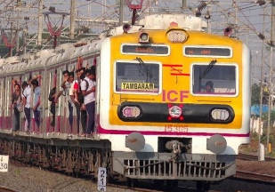
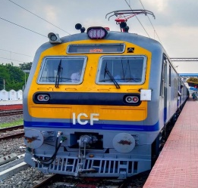
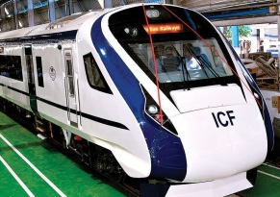

DPRS Types in Indian Railways
Diesel Multiple Units-DMU/DEMU
Electrical Multiple Units-EMU
Mainline Electrical Multiple Units-MEMU
Train sets -Semi High Speed
Trainsets - High Speed

Slide 29
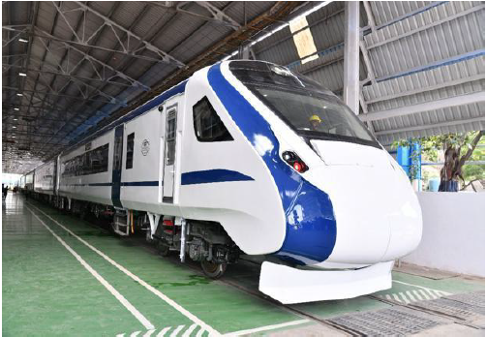
Trainset – Semi High Speed T-18
Train-18 is 16 car train with 4 basic unit i.e. Two number of end basic unit (DTC-MC-TC-MC) and two number of middle basic unit (NDTC-MC-TC-MC)
Semi-high speed (160 kmph) multiple unit train-set.
Train-18 is provided with IGBT based energy efficient 3 phase propulsion system and regenerative braking
Stainless steel car body with continuous window glasses
All propulsion equipments are shifted from onboard to under-slung. All power components such as line & traction converters, auxiliary converter, air compressor, battery box, battery charger, brake chopper resister are mounted under the frame
Zero discharge vacuum-based bio-toilets
Modern bolster-less design bogies with fully suspended traction motors,
Train-18 has 50% powering i.e. Every alternate coach is powered
Ethernet backbone

Slide 30

Trainset -High Speed
Operational speed greater than 200 Kilometer per hour on existing track
Operational speed greater than 250 Kilometer per hour on new track
Significantly faster than traditional railway trains
E.g.- Bullet Train (Japan)
- ICE (Germany)
- TGV (France)
- CRH (China)

Slide 31
Rolling stock requirement
Self propelled, fixed composition and bi-directional
High level of technology
Limited axle load High traction power 3 Phase Propulsion System
Power electronic equipment: GTO, IGBT based Control circuits
Computer network- centralised train control system
Automatic diagnostic system
Optimised aerodynamic shape
In-cab signalling system/s
Several complementary braking systems
Airtight structure
High level of RAMS (Reliability, Availability, Maintainability and Safety)

Slide 32
Advantages of Trainsets
Better acceleration and deceleration
Saving in run time
Energy efficient
Enhanced safety
Reduced maintenance
Improved reliability
Reduction in pollution
Improved passenger comfort
Improved line capacity
Designed to handle super dense crush load

Slide 33
Enhanced safety
Most DPRS have regenerative and Electro pneumatic braking features, Emergency braking distance is reduced
Reduce jerks due to smoother acceleration and deceleration due distributed power and traction forces
Anti-telescopic design

Slide 34
Reduced maintenance
Reduced wear of track and wheels since power is distributed
Regenerative & EP braking improves wheel life
3 phase IGBT VVVF propulsion
AC traction motor

Slide 35
Improved reliability
3 phase IGBT technology is highly reliable
Distributed powering has a lot of in built redundancy, since 50-60 % of axles are powered.
Man machine interface gives apt feedback about any issues in the propulsion system.
In-built fault diagnostics.

Slide 36
Improved line capacity
Faster acceleration & deceleration leads in time required to clear a critical section
Higher carrying capacity of DPRS will reduce number of trains required for same throughput.

Slide 37
THANK YOU

