Slide 1
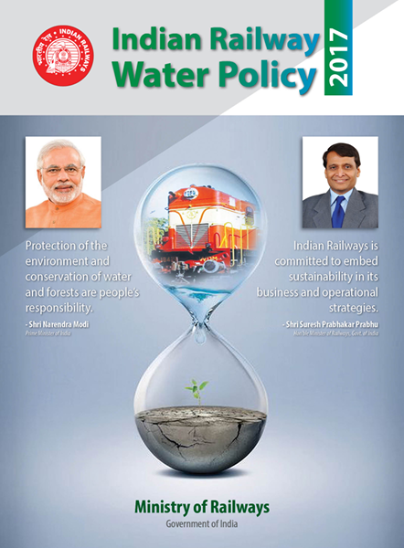

Slide 2
Objectives
After this lecture the trainees will be able to understand about:
Sources
Importance
Earlier management
Scarcity
Introduction as per UNO
Worldwide Facts as per UNO
Back ground for IR water policy
IR water policy in detail

Slide 3
Introduction
Water
Is must for all life forms on earth.
Hence, water is important amongst the 4 natural resources, Forest, Wind, Water and Solar energy
National institution for transforming India (NITI Aayog) report 2019 states that:
India is also suffering from the water crisis.
> 600 million of its population is water-deprived.
21 Cities — including Bangalore, Delhi, Hyderabad and Chennai — probably exhausted their groundwater resources in 2021.

Slide 4
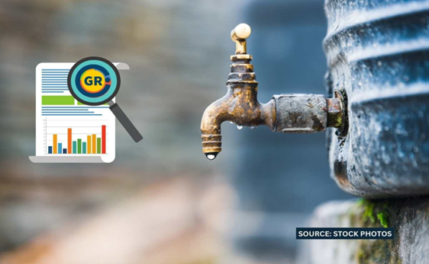
INTRODUCTION
Many regions in our country are currently undergoing the process of ‘water stress’(when the water availability falls below 1000 m³ per person per day)
Research shows that by 2025, India, along with many other countries will face a serious scarcity of water.

Slide 5
Some Facts and Figures
The total volume of water on earth’s surface- 96.5%
The total volume of usable freshwater- 2.5%
The vol.of freshwater in ice-sheets & glaciers- 70%
Stored groundwater- 30%
Precipitation (rainfall) in India- 4% of earth’s total
India’s rank in the world for water availability per person (per annum)- 133

Slide 6
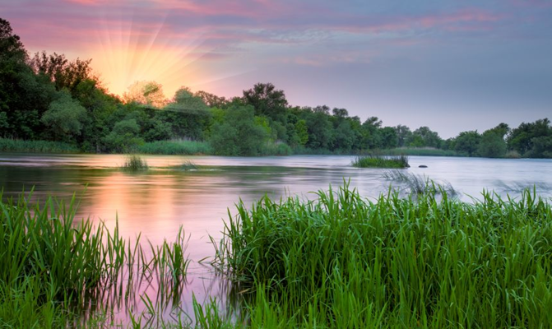
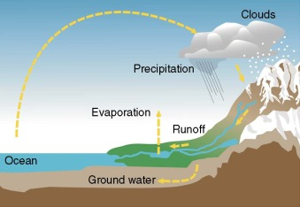
SURFACE WATER & GROUND WATER
Surface water participates in the water cycle, which involves the movement of water to and from the Earth’s surface. Evaporation and seepage of water into the ground, cause water bodies to lose water. Water that seeps deep into the ground is called groundwater.
Surface water and groundwater are reservoirs that can feed into each other.

Slide 7
types of surface water
There are three types :
(I) Perennial, or permanent : Persists throughout the year and is replenished with groundwater when there is little pption. e.g. Lakes, rivers, and wetlands(marshes and swamps)
(II) Ephemeral, or semi-permanent : Exists for only part of the year. It includes small creeks, lagoons, and water holes.
(III)Man-made : Found in artificial structures, such as dams ,ponds, wells, canals and constructed wetlands.

Slide 8
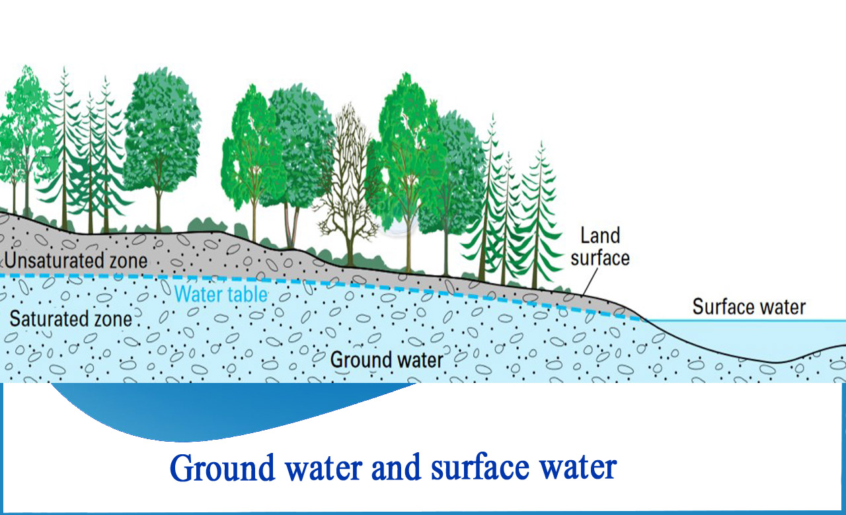
GROUND WATER
Groundwater is the water present beneath Earth's surface in rock and soil pore spaces and in the fractures of rock formations.

Slide 9
Sources of water
Surface water:
a. Rivers: i) Himalayan Rivers
(Ganga, Indus & Brahmaputra ii)Peninsular River (Mahanadi,Krishna,Godavari,Kaveri
b. Lakes
c. Ponds
d. Streams
e. Oceans
2. Under Ground water:
a. Open Wells
b. Tube Wells
c. Infiltration Wells
d. Springs

Slide 10
Availability of Surface water
Rain is having uneven water distribution: Most of the rainfall occurs in 3- 4 months of a year that varies between 100 mm (Rajasthan) to 10000 mm (Meghalaya)
India receives an average rainfall of about 1170mm including snow fall, which corresponds to an annual precipitation of 4000 BCM.
Out of this 53.3% is lost due to evaporation leaving behind 1869 BCM as water availability in the country in the form of rivers, lakes, tanks, ponds and reservoirs.

Slide 11
Availability of water
Due to geological and other factors, the utilizable water availability is 1123 BCM per annum, comprising of 690 BCM of surface water and 433 BCM of replenishable ground water.
The av. annual per capita water availability in the years 2001 and 2011 was assessed as 1820 and 1545 m³ respectively which may reduce further to 1341 and 1140 in the years 2025 and 2050 respectively.

Slide 12
Water Stress Index ?
It relates the total freshwater resources with the total population in a country and indicates the pressure of population puts on water resources, including the needs for natural ecosystems.
In a country, if the amount of renewable water per person per year is:
below 1,700 m³, is said to be water stressed condition,
below 1,000 m³, water scarcity.
below 500 m³, absolute water scarcity.

Slide 13
Water Stress/SCARCE
Due to high temporal and spatial variation of precipitation, the water availability of many region of our country is much below the national average and can be considered as water stressed / water scarce conditions.
Almost 76% of people are already living with water scarcity in India.

Slide 14
Facts and Figures as per UNO
More than 90% disasters are water related.
2.3 billion people (40%) live in water stressed area (live without safe water at home)
80% of wastewater is discharged untreated into the environment.
One in four primary schools have no drinking water service, pupils using unprotected sources or going thirsty.
More than 800 children under five years of age die every day from diarrhea linked to unsafe water and poor sanitation.
Globally, 80% of the people who use unsafe and unprotected water sources live in rural areas.

Slide 15
Facts and Figures as per UNO
For the 68.5 million people who have been forced to flee their homes, accessing safe water services, is highly problematic.
Around 159 million people collect their drinking water from surface water, such as ponds and streams.
Around 4 billion people – nearly 2/3 of the world’s population – experience severe water scarcity during at least one month of the year.
700 million people worldwide could be displaced by intense water scarcity by 2030.
For Drinking, washing, cooking and maintaining proper hygiene, water required, is a minimum of 70 liters per person per day.

Slide 16
Facts and Figures as per NITI Aayog report
According to the “Composite Water Management Index” report published by Nitti Aayog in Sept. 2024,
India is placed at 120th amongst 122 countries in the global water quality index 2024, with nearly 70% of water being contaminated.

Slide 17
Some Facts & Present Scenario of Water Resources in India
About 18 % of the world’s population (138 crores) lives in India .
Having only 4% of world’s renewable water resources & 2.4% of land area.
India is the largest user of groundwater in the world.(25% of total ground water use in the world is in India). India is ahead of China and USA.
It uses an estimated 230 BCM of groundwater per year which is over a quarter of the global total.
>60% of irrigated agriculture depends on Ground Water.
About 85% of drinking water supplies are dependent on groundwater.
In the broader sense we can say that roughly 80 % of India's 138 crores residents depend on groundwater for both drinking and irrigation.

Slide 18
the Status of Water Management in India ?
Current Status: India extracts most groundwater in the world, more than the 2nd and 3rd largest extractors (China and the United States) together. However,
Only 8% of the extracted groundwater in India is used for drinking, 80% goes to irrigation and remaining 12% to industrial uses.
The CWMI by NITI Aayog has sounded a note of caution about the water crisis in India, with more than 600 million people facing acute water shortages.
It is also projected the country’s water demand to be twice the available supply by 2030.

Slide 19
Need for water policy IN IR, 22 March,2017
Lowering of ground water level.
Occurrence of frequent drought.
Water scarcity being faced in many regions.
Inadequate availability of water at Rly. stations and colonies in water scarce areas has been impacting rly working and operations.
In a case on Environmental pollution before NGT, Delhi, an order have been issued- directing Railways that effluent generated at station and depots should not be permitted to seep into the ground,
it should be discharged into ETP/STP to be located near major railway stations and depots and treated water shall be seep or recycled for inferior use.
GOI has committed to improve the water use efficiency by 20%, to UN Framework Conversion on Climate Change (UNFCCC) in 2015. This is a legally binding commitment in India.

Slide 20
Need for water policy
It is observed that water consumption and water demands details of many establishments of IR, are not available .
At many locations fresh water is being consumed for non-potable purpose for which recycled water can be used after treatment.
Being major consumer of water, to take adequate and effective measures to improve mgt. of demand as well as supply to be as a part of environment objective and avoid water scarcity coming in the way of operations and maintenance of railways.
It has been decided to issue the policy instructions on water mgt. on IR to ensure clarity on the subject and systematic approach in water mgt.

Slide 21
Water Management Plan (WMP)
Each Division/Workshop shall prepare Water Management Plan. It shall have demand and supply along with water conservation measure.
Water Consumption for potable & non potable purpose
Available water resources
Quality of water
Treatment method being used
Detail of major water supply installations
Includes Target of water use efficiency.

Slide 22
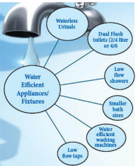
Target
Plan should indicate-
Target of water use efficiency
Plan for audit of functioning RWHs
Target for new recharge structures,
WRP, ETP, STP
Undertaking water audits
Setting up ETP/STP
Use/ proliferation plan of water efficient fixtures, installation of water meters.

Slide 23
TARGET
Zonal railway shall endeavor to reduce the demand for fresh water by quantifying targets each year.
Based on WMP-
The railways shall assess the quantum of work required, along with cost, duly giving priorities in accordance with water situations in the area.
Make an action plan for water conservation in minimum possible time.
Each ZR/PU shall endeavor to make at least one unit(Colony, WS, Shed, Station ) every year to become water positive.
Recycled Water+ Water harvested> Water extracted and consumed

Slide 24
Upgrading water supply systems
Water supply represents a vital problem for people, this need to know the Information regarding
Consumptions
Resources
Production
Continuous supervision of water supply process in order to allow any problem that could appear to be solved.
In the same time, to maintain normal functioning parameters.

Slide 25
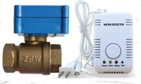
Upgrading water supply system
Manually operated valves Automatic valve (actuating mechanism) – remote control, regulate flow automatically
Use of SCADA: (where ever possible)
To control various equipment and monitor the water throughout the entire process(Large coach watering station, depots & colonies shall be the 1st focus area )
Level transducer that track water levels in large reservoirs and tanks.

Slide 26
Upgrading water supply system
Pressure transducer in pipes to ensure that water is pumped and flowing efficiently.
Flow meters that increase how many litres of water/mts. are being delivered.
Pressure-sustaining, pressure-reducing and other valves that open and close automatically to adjust the rate of water flow.
Phasing out of valve man : Introduction of Self actuated valve / use of SCADA shall result in reducing man power by jan.2019.

Slide 27
Measurement and Accountal of water consumption in IR
Presently Most of the water supply to various IR establishments is not metered. By metering water supply & consumption can be known. This will enable in ascertaining water wastage/saving opportunities.
Hence smart meters may be provided to major service buildings, ws, depots/sheds, stations supply points and major distribution ends points which will be useful for planning appropriate water conservation by maintaining data of supply and consumption.
Smart meters may be useful for measurement,accountal and monitoring of water consumption. Performance assessment and monitoring of this by each unit incharge on monthly basis.

Slide 28
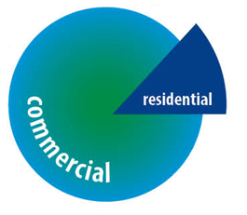
Conti….
Application of differential water tariff (%):
Residential and Commercial supplies are not separately metered.
It shall be the endeavor of all zonal railways to ensure that supply is paid rationally on the basis of actual use in the categories of residential and commercial by making suitable changes to the distribution network and installing meters.
This shall be achieved in a period of
two years (by Jan 2019).

Slide 29
WATER AUDIT
Objective: In order to find ways to optimize the use of scarce resource as well as, Reduce, Reuse, Recycle of waste water.
To measure:
Extent of fresh water use
Water losses in the system
Waste water generated
“If you can't measure , you can't manage it.”

Slide 30
WATER AUDIT
Audit team:
Engineers
Water Quality Expert
Various Instruments /Equipment
As per Railway board’s order,
Audit has to be carried out through 3rd party
a) At major water consumption centers in IR (> 5 lakh liters/day) and/Or,
b) Water supply is from ground water source and ground water block falls in “Semi-critical”, critical or overexploited category. and/Or,
c) Railway is purchasing substantial quantity of water from Municipality.

Slide 31
WATER AUDIT
Analysis of Water Audit:
Follow up action (short, medium & long term plan for water mgt. )on the recommendation of water audit with fixed time line so savings and water use efficiency are achieved as quickly as possible.
Water audit : 1371 (up to march 2024)

Slide 32
RAIN WATER HARVESTING(RWH)
RWH and conservation is a process of collection of rain water for future productive use.
The rain water so collected can be stored for direct use after disinfection or can be recharged into the ground water.
The objective of RWH and conservation is to make optimum use of rain water at the place where it falls.

Slide 33
RAIN WATER HARVESTING(RWH)
It has been decided that RWH systems shall be provided in all existing establishments having roof top area is more than 200 sqm. subject to techno-economic feasibility.
Out of these, priority should be given to those areas where Ground Water Blocks falls in ‘Semi-Critical ’, Critical’ or ‘Over-exploited’ category as per Central Ground Water Board categorization.
This is subject to the requirement for ground water recharge for a particular area as per the CGWA’s guidelines.

Slide 34
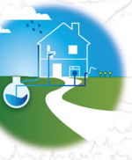
RAIN WATER HARVESTING(RWH)
There are two main techniques of RWH.
Storage of rain water for future use.
Artificial recharge to ground water.
Knowledge of geological and hydrological features of the area is necessary for selecting the site and type of recharge structures.
Artificial recharge structures are generally pits, trenches, abandoned dug-wells, hand pumps, gravity head recharge tube-wells, recharge shaft etc.
RWH may also be done by reviving old water bodies on railway land and creating new water bodies wherever feasible.
Periodic maintenance of recharge structures is important to ensure its proper functioning.
At present RWH-7692 (march 2024), Natural water bodies revived 845 which was non functional.

Slide 35
Waste water treatment (ETP/STP)
IR largely consumes fresh water for non-potable uses at present. Therefore, there is substantial scope for recycling the waste water after treatment for using the same for non-potable purpose like washing of Platforms, Aprons, Coaches, Gardening and flushing of toilets etc.
Waste water arising in railways in generally from railway tracks & PFs, pit lines, workshops/sheds as also sewage from residential/service buildings. The treatment methods and re-use potential depend upon the type of waste water.
Technology for treatment needs to be chosen to get maximum benefits with a minimum cost.
Up to march 2024: 225 ETP and 200 STP

Slide 36
Water Recycling Plant (WRP)
STPS/ETPs/WRPs have to be provided at railway stations, colonies, workshops/sheds, hospitals etc., including other units as per the guidelines of CGWA and/or recommendations of water audit report.
As per Board letter, Railways were directed to prioritise the installation of WRPs by proposing the works in the Annual Works Programme.
All coaching depots washing more than 200 coaches in a day shall be provided water recycling plant along with ACWP to reduce fresh water consumption in first phase.

Slide 37
Water Recycling Plant (WRP)
Coaching depots are generally provided with manual coach washing system which consumes huge quantity of water.
Water Recycling Plants along with the automatic coach washing plants shall be provided at all coaching depots to reduce fresh water consumption.
At present WRP-142 (march 2024)

Slide 38
Water Recycling Plant (WRP)
There are around 350 coach watering stations in IR. All these stations, a large amount of water is wasted due to overflow and leakages. It shall be mandatory to provide a WRP in all such stations.
Auto detachment of the flexible water filling pipe on completion of watering is also made mandatory in all coach watering stations.
In case of a difficulty in doing this arrangements, approval of DRM shall be obtained and kept on record.
Quick watering locations -128 over IR (up to march 2024)

Slide 39
Funds
Works of water mgt. can be done under Revenue as well as Plan expenditure depending upon the type of work location etc.
RWHs and water audit for the existing establishments need to be undertaken on priority using Revenue funds as well as through plan fund, whenever the same are taken as a part of a sanctioned work.
The work of WRPs/ETPs/STPs may be undertaken through regular works programme.

Slide 40
Arrangement of Wrp on ppp/boot base
All ZRs shall attempt to enter into PPP/BOOT arrangements with interested parties by calling tenders with suitable eligibility criteria to install waste water recycling plants on railway land with long term agreement (15-30 yrs.) for buying back recycled water from bidder.
Equivalent amount of fresh water supply may be reduced from the daily consumption.
Railway may also undertake some of the aforesaid works through CSR as per extent Board’s policy.

Slide 41
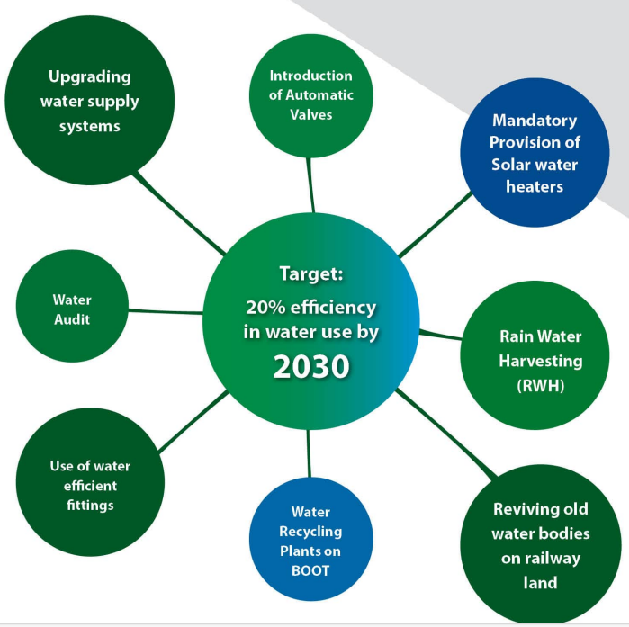
Indian Railway Water Policy

Slide 42
Abbreviations:
ETP: Effluent Treatment Plant; : To treat waste water
STP: Sewage Treatment Plant : To treat waste water
WRP: Water Recycling plant : To recycle water
CWMA- Composite water mgt. authority
CGWB-Central Ground Water Board categorization.
BCM: billion cubic meters – (1km³ = 1 BCM).
National Commission on Integrated Water Resources Development (NCIWRD)
CPWD -Central Public Works Department
PPP-Public-Private Partnership
BOOT-Build-Own-Operate-Transfer

Slide 43
Up to march 2024
Eco- smart stations 36 (water & energy audit)
STP-: Treated water is often reused for cleaning trains, platforms, and other railway operations, as well as for irrigation and toilet flushing, reducing fresh water consumption
Ponmalai (Trichy Division) : The treated water is used to maintain green spaces & gardens at the railway's rest houses.

Slide 44
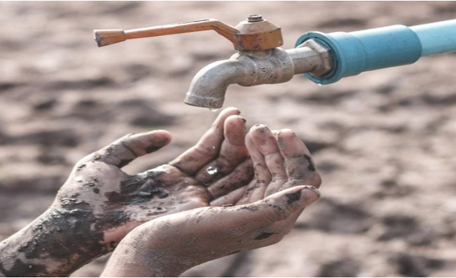
UNO & NITI AAYOG
According to the report of Niti Ayog, GoI, the states of Maharashtra, Gujarat, Karnataka, Jharkhand, Andhra Pradesh and Rajasthan, Uttar Pradesh, Punjab, Delhi, Bengaluru, and Chennai have been facing serious Water scarcity since 2018
Gujrat- Jal Jeevan Mission
Maharashtra- Jalyukt Shivar Abhiyan
Bihar – Jal jeevan hariyali
Overexploitation of Groundwater: 256 of 700 districts in India have reported critical or overexploited groundwater levels according to the most recent study of the Central Ground Water Board.

Slide 45
Current Government Initiatives Related to Water Management IN INDIA
National aquifer mapping and management program
Jal shakti abhiyan
National water policy, 2012
Atal bhujal yojana- Central sector scheme for fascilating ground water mgt.
Jal jeevan mission-2019

Slide 46
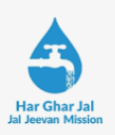
Jal jeevan mission - 2019
The Har Ghar Jal scheme, or the Jal Jeevan Mission, has been implemented in several states and Union Territories in India: The scheme aims to provide clean & sufficient drinking water to all rural Indian homes through tap water by 2024.
States | Coverage
Goa | The first state certified as 100% tap water access in all rural houses by August 2022
Dadra and Nagar Haveli and Daman and Diu | The first Union Territory certified as "Har Ghar Jal" in August 2022, with 100% tap water access
Arunachal Pradesh | 97.83% of rural areas have tap water connections
Bihar | 96.42% of rural areas have tap water connections
Uttarakhand | 87.79% of rural areas have tap water connections

Slide 47
This is exactly what we fear will happen very soon, if we don’t wisely use & conserve our water resources.
Thank you

