Slide 1
FAILURE ANALYSIS
M.Chandra.
Lect./EM

Slide 2
Points of discussion
Need for failure analysis.
Defining failure of component.
Causes of failure of mechanical components.
General procedure of failure analysis.
Failure mechanisms

Slide 3
Need for Failure Analysis
Whenever failure of a component or a complete assembly takes place, disruption is observed, reliability and punctuality are hampered. In some of the cases safety is violated. Hence, whenever failure of any component takes place it becomes necessary to investigate it properly so that its recurrence is avoided.

Slide 4
When to Consider Failure
In general, an engineering component or assembly is considered to have failed under the following three conditions when the component is
Inoperable
Operates but does not perform the intended function
Operates but safety and reliability is very poor

Slide 5
Failure Analysis
Failure analysis is a systematical approach of investigation to establish the important causes of the failure.
Therefore , it is worth to familiar with
Fundamental causes of failure of mechanical components
General approach to be used for the failure analysis and prevention.

Slide 6
Fundamental Causes of Failure
Improper design
Improper selection of material
Defect and discontinuities in metal itself
Improper processing of materials
Poor service conditions
Poor assembly
Poor maintenance

Slide 7
Improper Design:
Design is developed without full knowledge of stress conditions owing to complexity of the geometry and
Inability to use proper criteria for designing the engineering components.
Duplicating a successful design for more severe loading condition.

Slide 8
Improper Selection Of Material
Selection of a material for developing the design of a mechanical component in sight of operating conditions should be based on expected failure mechanism such as
Ductile and brittle fracture.
Fatigue.
Creep.
Corrosion.
Wear etc.

Slide 9
Contd.
For each type of expected failure mechanism a combination of the mechanical , physical and chemical properties should be possessed by the potential material to be selected for developing a design.

Slide 10
Contd.
Deficient material selection can occur due to
Reliance on test data for selection on material.
Inability to select material in light of the expected failure mechanism to develop criteria for the design purpose.

Slide 11
Contd.
Failure Mechanism Design Criteria
Ductile fracture Yield strength
Brittle fracture Fracture toughness, notch toughness, DBTT
Fatigue Fatigue strength with stress raiser, hardness
Creep Creep rate at given temperature
Plastic deformation Yield strength
SCC Toughness, corrosion resistance to specific temperature

Slide 12
Presence of defects and discontinuities in raw/stock metal
Materials being used for fabrication of an engineering component may be deficient in many ways
For eg: Rods , plates and flats produced by bulk deformation based process like rolling , forging and extrusion may have unfavorable flow of grains, surface cracks etc.
While casting may have blow holes, porosity and dissolved gasses in solids

Slide 13
Unfavorable manufacturing processing conditions
A wide range of manufacturing processes are
Casting
Forming
Machining
Welding
cleaning
Other processes like heat treatment , case hardening , surface coating etc.

Slide 14
Contd.
The selection of inappropriate combination of process parameters for each of above mentioned manufacturing processes can lead to development of
Discontinuities
Defects
Unfavorable metallurgical changes and so deterioration in performance of final product during the service.

Slide 15
Contd.
These imperfections and impurities are mostly process specific and can exist in variety of forms due to improper selection of manufacturing processes and their parameters.
For eg : in welding , as crater ,SC, PMZ , weld toe etc.

Slide 16
Poor service conditions:
Failure of an engineering component can occur due abnormal service condition experienced by them for which they are not designed.
These may appear in form of exposure of component to –
Excessive high rate of loading
Unfavorable oxidation, corrosive, erosive environment
Higher or lower temperature ,conditions for which it has not been designed.

Slide 17
Poor assembly
Error in assembly can be resulted in various ways such as:
Ambiguity in instructions
Insufficient or inappropriate assembly procedure
Misalignment
Poor workmanship
Sometimes failures are also caused by the inadvertent error performed by the workers during assembly.

Slide 18
Poor Maintenance Strategy
The failure of many moving mechanical components takes place due to poor maintenance plan.
A very developed maintenance plan indicating each and very important step to be used for maintenance such what, when, where, who and how is specified explicitly.
Lack of information on proper schedule of maintenance ,procedure of the maintenance frequently cause premature failure of the moving components .

Slide 19
General procedure for failure analysis
In the field of engineering ,mechanical components are :
Made using variety of material.
Processed by different manufacturing processes and
Used in extremely wide range of service condition.
Potential causes of failure of the components and their mechanism also numerous.

Slide 20
Establishing Failure Analysis procedure
Therefore, procedure of failure analysis of each component should be different.
Failure analysis procedure for each case must be developed after giving proper thought on
Possible sequence of events before failure along with proper evaluation of the situation
Proper consideration of material, manufacturing process, service history and actual working condition.

Slide 21
So how to go ahead
The sequence of steps will largely be determined by the findings of the investigation at any stage.
Main objective of collecting evidences regarding causes of the failure is to establish sequence of events prior to the failure.
Provide suitable recommendations can be made to prevent the similar failure in future.

Slide 22
General procedure for Failure Analysis
Collection of background information about failed components.
Preliminary examination of failed components.
Macroscopic observation of fracture surfaces and components.
Selection, preservation of the sample.
Chemical analysis.
Evaluation of the mechanical properties of the failed components.
Microscopic observation of fracture components
Establishing the fracture mechanism.
Analysis of findings of inspection.

Slide 23
FRACTURE
Fracture is a separation of an object into two or more pieces under the action of load.
Brittle fracture:
It is the sudden , very rapid cracking of component under stress where metal exhibits little or no evidence of ductility before fracture.
Rapid crack propagation
Perpendicular to applied load
Crystalline in nature
Ductile fracture:
Fracture occurs with plastic deformation.
Fibrous in nature.

Slide 24
Factors contributing brittle failure
Three basic factors contribute to a brittle –cleavage type of fracture:
A triaxial state of stress.
A low temperature.
A high strain rate / a rapid rate of loading.

Slide 25
BRITTLE AND DUCTILE FRACTURE

Slide 26
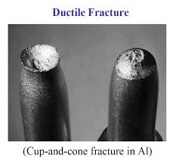
Brittle & Ductile fractures

Slide 27
DUCTILE-TO-BRITTLE TRANSITION
The notch bar impact test is most meaningful when conducted over a range of temperature, so that the temperature at which the ductile to brittle transition takes place can be determined.
The energy absorbed decreases with decreasing temperature. But for most cases the decrease does not occur sharply at a certain temperature.

Slide 28
Contd.
Transition temperature is a important factor in selecting material from the stand point of notch toughness.
The material with the lowest transition temperature is to be preferred.
Reliance on impact resistance at only one temperature can be misleading.

Slide 29
Stress-Strain Curve
STRESS STAIN CURVE FOR BRITTLE AND DUCTILE FALURE

Slide 30
TOUGHNESS VS TEMP
Toughness is a function of temperature & the impact value of a material changes with temp.
Generally, at lower temps, the impact energy of a material is decreased
Charpy or Izod test is often repeated many times with each specimen tested at a different temperature.
Material is more brittle at low temperatures & toughness is low.
Material is more ductile at high temperatures & toughness is higher.

Slide 31
METALLERGICAL FACTORS AFFECTING TRANSITION TEMPERATURE
Changes in chemical composition or microstructure of mild steel can
change in transition temperature.
The large change in transition temperature result from changes in
the amount of carbon and manganese.
Transition temperature is raised by carbon content in steel.
Transition temperature is lowered by the Mn content in steel.
Mn : C ratio should be at least 3:1 for satisfactory notch toughness.
P has a strong effect in raising the transition temperature.

Slide 32
Contd.
Ni (upto 2%) is beneficial in lowering transition temperature.
Si (above 0.25%) appears to raise the transition temperature.
Mo raises the transition temperature almost as rapidly as carbon.
Cr has little effect.
O2 content has a strong effect in raising transition temperature.
Grain size has a strong effect on transition temperature-decrease in grain size decreases transition temperature.

Slide 33
Fatigue failure
Fatigue is the progressive, localized, permanent structural change that occurs in a material subjected to repeated or fluctuating strains at stresses having a maximum value less than the tensile strength of the material.
Fatigue failure is caused by the simultaneous action of cyclic stress, tensile stress and plastic strain.

Slide 34
Appearance of fatigue fracture
Fatigue results in a brittle appearing fracture, with no gross deformation at the fracture.
A fatigue failure can usually be recognized from the appearance of the fracture surface which shows a smooth region due to rubbing action as the crack propagates through the section and a rough region where the material has failed in a ductile manner when the cross section was no longer able to carry the load .
Frequently the progress of the fracture is indicated by a series of rings or “beach marks” progressing inward from the point of initiation of the failure.
Fatigue failure usually occurs at a point of stress concentration.

Slide 35
Type of loading:
Features on the fracture surface are strongly affected by the type and magnitude of loading.
Unidirectional bending:
Reversed bending:
Rotational bending:
Torsional loading:

Slide 36
Type of loading:
Unidirectional bending:
Fatigue cracking may be initiated at the point of highest stress, adjacent to the rigid mounting.
Several cracks may have been active before one of them become large enough to cause the final fracture.
Reversed bending:
If the loading is alternating instead of fluctuating , fatigue may be initiated on both sides. Final fracture zone will be in between two fatigue zones.
The size of final fracture zone is indicative of the relative loading.

Slide 37
Type of loading:
Rotational bending:
Rotating round shaft is commonly subjected to rotational bending.
Every point on the periphery sustains a tensile stress, then a compressive stress , once every revolution.
Asymmetrical development of crack front to extend preferentially in the direction opposite to that of rotation.
The crack front usually swings around about 15⁰ or more.
Distribution of the origins of a multiple-origin crack.

Slide 38
Type of loading:
Torsional loading:
Same beach marks and ridges as those produced by bending stress,
Longitudinal stress raisers are of considerable practical importance.
Orientation of fracture is 45⁰ to the shaft centerline.
Fracture face typically has one or more origins.

Slide 39
Fatigue fracture

Slide 40
FATIGUE FRACTURE

Slide 41
FATIGUE FRACTURE

Slide 42
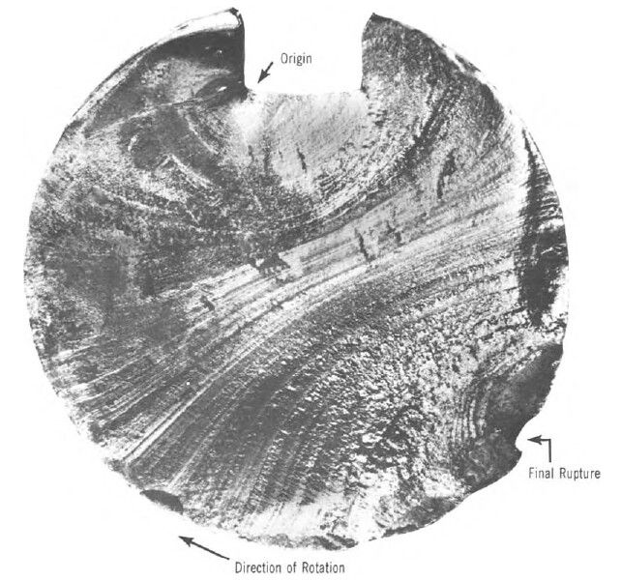
FATIGUE FRACTURE

Slide 43
Ratchet mark

Slide 44
Torsional fatigue fracture of a shaft inside a hub

Slide 45
Reversed torsional fatigue
Two 45⁰ cracks started at the keyway
Failure of a splined shaft

Slide 46
Endurance limit
Fatigue limit (endurance limit) occurs for some materials (e.g. some Fe and Ti alloys). In this case, the S—N curve becomes horizontal at large N. The fatigue limit is a maximum stress amplitude below which the material never fails, no matter how large the number of cycles is.

Slide 47
S-N curve

Slide 48
Factor affecting Fatigue life & Solution
Quality of the surface (scratches, sharp transitions).
Magnitude of stress
Solutions:
Polishing (removes machining flaws etc.)
Introducing compressive stresses (compensate for applied tensile stresses) into thin surface layer by “Shot Peening”
Case Hardening
Optimizing geometry - avoid internal corners, notches etc.

Slide 49
Thank You!

