Slide 1
Overview Of Freight Operation Over IR, Mission 6MT/Day
MUKUND BIHARI
Lecturer(C&W)

Slide 2
EARNINGS ON INDIAN RAILWAYS
Major source of Earnings on Indian Railways –
Passenger Earnings
Other Coaching Earnings
Goods Earnings
Sundry Earnings
Revenue and Capital Expenditure on Indian Railways are being met from the above major source of Earnings.
Revenue Expenditure is met for Salaries, Fuels, Maintenance, etc.
Capital Expenditure is met for Gauge Conversions, Construction of New Lines, Station Development, Tractions, etc.
To meet Revenue and Capital Expenditure on Indian Railways, Earnings Budget has a prominent role.
Surplus Earnings will be contributed to the contingency fund of Government of India.

Slide 3
SOURCE OF EARNINGS ON INDIAN RAILWAYS
Passenger Earnings (Approx 20% of total earnings ) | Suburban First Class and General class passengers. Non-Suburban First AC, Second AC, Third AC, First Class, Sleeper Class and Second Sitting passenger earnings.
Other Coaching Earnings (Approx 3% of total earnings ) | Parcels Luggage Special Trains (other than Military) Special Trains (Military Specials) Penalties imposed by Ticket Checking staff/Station Masters. Platform tickets Cloak Room charges Postal Haulage charges Cancellation and Clerkage charges. Identity Cards Demurrage/Wharfage Miscellaneous

Slide 4
SOURCE OF EARNINGS ON INDIAN RAILWAYS
Goods Earnings (Approx 75% of total earnings ) | Freight earnings - commodities viz., Coal, Cement, Iron Ore, Foodgrains, Fertilizers, Petroleum Products, Container services, Raw Material for Steel Plants (RMS) and others. Miscellaneous Goods earnings - Demurrage/Wharfage - Stacking charges - Siding charges - Trip charges - Shunting charges
Sundry Earnings (Approx 2% of total earnings ) | Rent & Tolls Non Fare Revenue (Commercial Publicity) Catering Parking ATMs Pay & Use Toilets Commercial Plots Sale of Time Tables

Slide 5
Industry Scenario
Indian Railways records 1434.03 MT freight loading till Feb 2024 monthly freight loading of 136.6 MT in Feb 2024, an improvement of 10.13% over last year freight loading for the same period.

Slide 6
Globalization Impacts On Logistics Sector
Logistics promotes and facilitates the process of globalization.
Logistics shifts from a purely cost center to center creating value.
Effective logistics management helps companies gain competitive advantage through value enhancement and cost reduction.
Trade is becoming more and more globalized, implying spetial expansion of the economy , more complex global economic integration, and an intricate network of global flows and hubs .
To stay competitive in complex business, all stakeholders must collaborate seamlessly across time horizons and functional and geographical barriers.

Slide 7
Changing Scene Posing New Challenges
Till the late 1970s, railway operations mostly confined to piece-meal loading and movement,individual goods sheds were designed to handle low volume of traffic.
Need of the times was huge marshalling yards, big transit/repacking sheds, transshipment sheds.
Block rake movement in early 1980s revolutionised Indian railway operations, and sounded death knell of marshalling yards with allied repacking/transit sheds.
The main bottleneck to improved efficiency was the absence of full-length goods shed lines capable of releasing an entire rake in a single placement.
Releasing a full rake within hours of placement required sufficient labour to begin with.

Slide 8
Changing Scene Posing New Challenges
With a an entire rake getting unloaded at the same time , it was no longer feasible to have secured covered sheds for keeping goods in safe custody.
Rake-load of consignments required spacious circulating areas for a large number of trucks to operate simultaneously.
At most places, railways face popular pressure for shifting of most of their major goods sheds to outside city limits.
There are two options available with railways at present.One, to permit private players to go in for their own freight terminals on private land with railways providing connectivity from the nearest station.Second, railways to go in for its own freight terminals on railway land to be managed by railways themselves or outsourced to private operators.

Slide 9
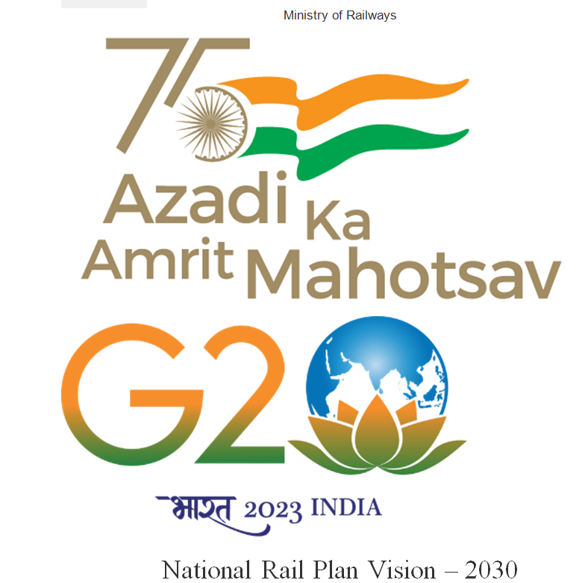
Posted On: 16 MAR 2022 5:12PM by PIB Delhi

Slide 10
National Rail Plan Vision -2030
The objective of the Plan is to create capacity ahead of demand.
‘Future ready’ Railway system
Increase modal share of the Railways in freight to 45%.

Slide 11
In the FY 2022-23, it recorded freight loading of 1512 Million Tones (MT). It witnessed an incremental loading of 94 MT from FY 2021-22. In the fiscal year 2021-22, the railways achieved freight loading of 1418 MT.
In the FY 2017-18, the national transporter achieved freight loading of 1161 MT followed by 1223 MT in FY 2018-19, 1210 MT in FY 2019-20, 1233 MT in FY 2020-21, 1418 in FY 2021-22 and 1512 MT in the previous fiscal year

Slide 12
In the FY 2023-24, the national transporter has achieved freight loading of 758.20 MT in the first two quarters.
It witnessed an improvement of 21.52 MT (approx.) over the last year’s loading for the same period.
In the FY 2022-23, it achieved freight performance of 736.68 MT from April-September.
A short-term plan namely Vision 2024 was also carved out from NRP by identifying and prioritizing certain works for achieving 2024 MT by the year 2024. (Approx. 6MT/Day)

Slide 13
“Hungry For Cargo”
IR has loaded 1512 MT during 2022-23 as compared to 1418 MT during FY 2021-22 registering an increase of 6.63% in terms of loading. This is the highest ever loading for IR in a Financial Year. During FY 2022-23 IR has achieved revenue of Rs. 2.44 Lakh Crores as compared to Rs.1.91 Lakh Crores during 2021-22 registering an increase of 27.75%.
(Posted On: 02 APR 2023 5:44PM by PIB Delhi)

Slide 14
“Hungry For Cargo”
IR has made sustained efforts to improve the ease of doing business as well as improve the service delivery at competitive prices which has resulted in new traffic coming to railways from both conventional and non-conventional commodity streams. The customer centric approach and work of Business Development Units, backed up by agile policy making, helped Railways towards this landmark achievement

Slide 15
“Hungry For Cargo”
The railway sector in India aims to contribute about 1.5% to the country’s GDP by building infrastructure to support 45% of the modal freight share of the economy.
Two Dedicated Freight Corridors (DFC), one on the Western route (Jawaharlal Nehru Port to Dadri) and another on the Eastern route (Ludhiana to Dankuni), have been fast-tracked.
On cumulative basis from Apr –Jan 2024, Railways have earned INR 1,40,623.4 Cr against INR 1,35,388.1 Cr over the last year from Freight loading.

Slide 16
“Hungry For Cargo”
New Line/ Doubling/ Gauge Conversion: 5243 kms of conversion have been achieved during 2022-23 as against 2909 kms in 2021-22. The average daily track laying in FY23 comes out to be 14.4 km per day, which is also the highest ever commissioning.
785 electric locomotives produced in this FY 2022-23 up to 31st January 2023.
As on 31st January, 2024, 82 Vande Bharat train services are operating across the Indian Railways.

Slide 17
“Hungry For Cargo”
As on 31st January, 2024, 82 Vande Bharat train services are operating across the Indian Railways.
Currently, a total of 2359 trips of Kisan Rail trains have been operated on 167 routes, wherein nearly 7.9 lakh Tonnes of consignments have been transported.
6427 (98.8% of total stations) Stations have been equipped with Electrical/Electronic Signalling Interlocking System up to 31.05.2023.
During 2022-23, 30 Freight Terminals were created as compared to 21 Freight Terminals in 2021-22.
Under the Union Budget 2024, Indian Railways has been allocated a highest ever capital outlay of 2.55 lakh crore.
The average Freight Train speed has increased to 44.36 kmph during 2021-22 compared to 42.97 kmph during 2020-21 (+3.23 %) (up to 31.12. 2021).
National Rail Plan aims to increase share of freight traffic from current 27% to 45% by 2030.

Slide 18
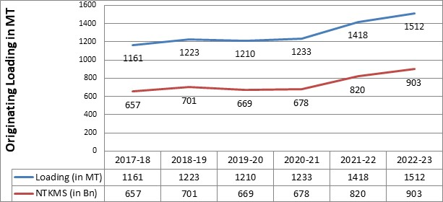

Slide 19
The commodity wise growth number show that IR has achieved growth in almost all commodity segments with the following growth rates
Commodity | 2021-22 | 2022-23 | Variation (MT) | % variation
Coal | 653 | 728 | 75 | 11.4 %
Balance of Other Goods | 118 | 129 | 11 | 9.3
Cement & Clinker | 138 | 144 | 6 | 4.3%
Fertilizer | 49 | 56 | 7 | 14.2 %
POL | 45 | 48 | 3 | 6 %
Container | 74 | 79 | 5 | 6.7%

Slide 20
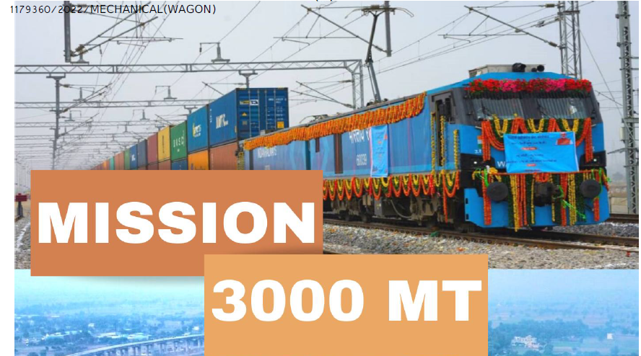
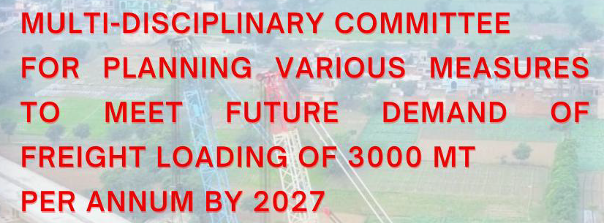

Slide 21
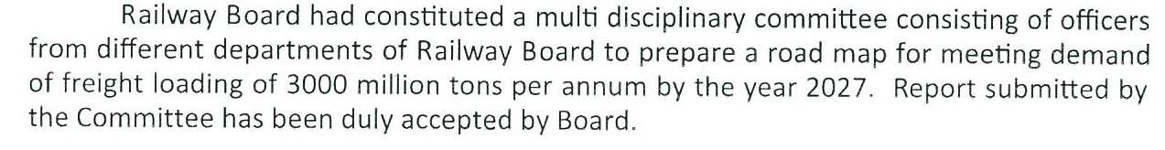
Mission 3000 MT
Vide L.No-ERB-1/2022/23/30 dated- 28/04/22

Slide 22
Report Of Committee On Mission 3000 MT
IR needs to gear up to target the much higher traffic growth with ultimate objective to achieve 40-45% modal share by 2030 as envisaged in NRP.
Accordingly, the present Mission 3000MT has been formulated as an intermediate milestone towards achieving aforesaid ambitious target of NRP by identifying and prioritizing crucial capacity enhancement works for implementation before 2027.

Slide 23
Railway’s share in Logistics Market
Over last seven decades (from 1950-51 to 2021-22), India’s logistics market has grown manifold from 86.5MT(originating loading) to approximately 4500-5000 MT ( almost 55 times).
Rail Cargo has grown only by about 20 times from 73.2 MT to 1418MT (820 billion NTKM).
IR’s consistently declining market share from a whopping 85% in 1951 to 60% in 1991 and to a current level of around 27%-28%.

Slide 24
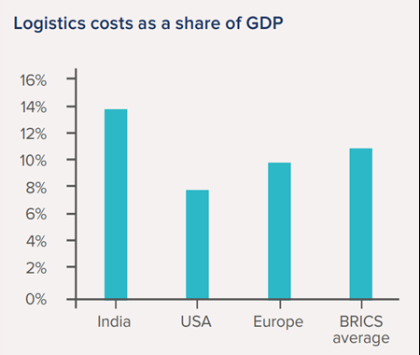
Logistics costs as a share of GDP

Slide 25
Strategies For Inducing Modal Shift To Rail
Different Scenarios
Scenarios are based on two major variables- average transit speed and overall cost to customer.
Scenario 1-Business as Usual (BAU): IR infrastructure remains the same along with full implementation of Bharat Mala (road network) & both DFCs
Scenario-2 - Enhancement of average Speed to 50 Kmph on IR network by implementation of capacity enhancement works including DFCs.

Slide 26
Different Scenarios
Scenario 3-Enhancement of average cargo Speed to 50 Kmph through capacity enhancement works coupled with 30% reduced cost to customers (except in 4 commodities) by 2026-27.
Scenario 4- Same infrastructure with reduction of cost to customers by 30%.

Slide 27
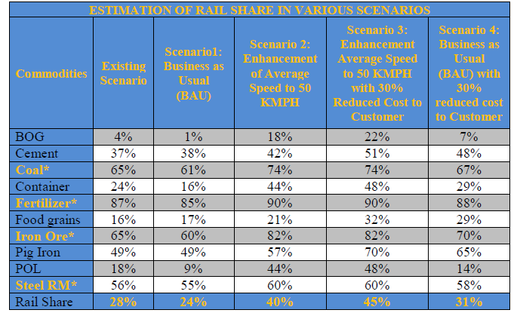

Slide 28
Action Plan for Mission-3000MT
For achieving Mission-3000 MT, an ambitious growth of CAGR of 16.5% is needed over next five years .
Accordingly, a threefold strategy has been formulated to address following constraints:
(i) Infrastructural constraints
(ii) Rolling Stock constraints (Commensurate
Augmentation and Up gradation of Rolling Stock
Fleet (Locos & Wagons) )
(iii) Marketing, pricing, customer service and policy
related issues.

Slide 29
ADDITIONAL WAGON REQUIREMENT
Additional requirement of wagons for 05 years
from 2022-23 to 2026-27 ----155872
Wagon requirement of 1,02,000 (1.02 lakh) was advised by Letter No.2017/TT-1/27/1 dated 19.01.22.
Additional 53,872 wagons shall be of new design wagons of 25t which can run on 25t routes in loading Railways where these routes will be proliferated with enhancement of capacity.

Slide 30
Balance Wagon Order Up To 29/02/24
NRC
RSP
46348
8661
TOTAL=55009

Slide 31
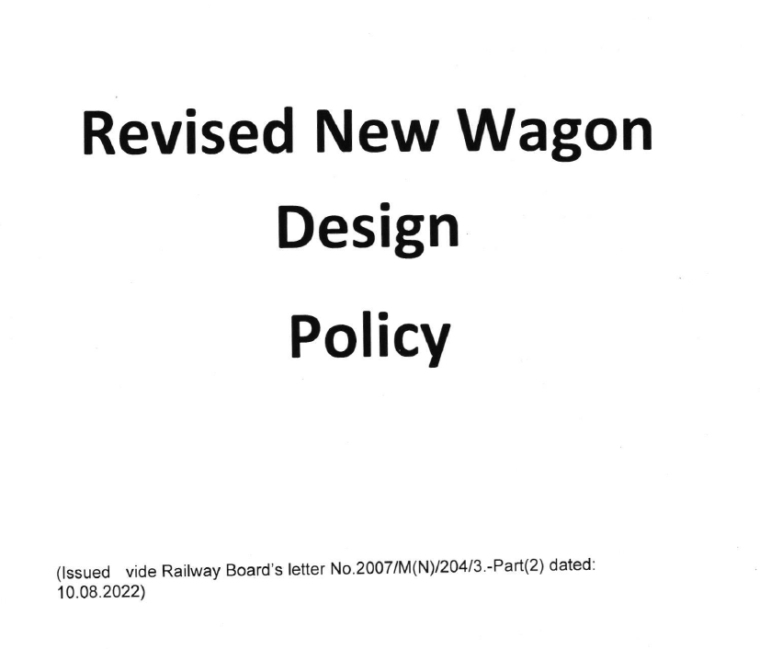

Slide 32
Revised New Wagon Design Policy
ln order to expedite the introduction of New Wagon Designs incorporating
latest technological advancements on Indian Railways to cater to the emerging need of
more efficient and cost effective transportation of existing commodities and expansion of
the commodity basket, a Revised New Wagon Design Policy has been framed

Slide 33
Stages of Approval/Clearance
Stage-l- Preparation & submission of proposal of
New wagon Design (NWD) by the wagon
lnvestor (Wl)
Stage-ll- ln-principle Clearance by the Committee
onWagon Design (CWD)
Stage-lll- Detailed Designing of the proposed NWD
Stage-lV- Manufacturing of two prototype Wagons

Slide 34
Stages of Approval/Clearance
Stage-V- Static and Dynamic testing of
prototype Wagons
Stage-Vl- Sanction & Manufacturing of NWDs
Stage-Vll- Field Service testing and trial of 2
rakes of NWD

Slide 35
Wagon Builders
Total 16 wagon builder`s (21 units).
Out of which 10 PVT Wagon builder`s.
02 PSU Wagon builder`s.
04 Railway workshops manufacturing Wagons.

Slide 36
PVT WAGON BUILDERS
Sl.No | Name | Units | Locations
1. | TEXMACO | 02 | KOLKATA
2. | HEI | 02 | KOLKATA
3. | TRS | 02 | KOLKATA/BHARATPUR
4. | JWL | 02 | KOLKATA/JABALPUR
5. | BESCO(F) | 01 | KOLKATA
6. | BESCO(W) | 01 | KOLKATA
7. | OFPL | 01 | GUJRAT
8. | JRIL | 01 | GUJRAT
9. | MODERN | 01 | GHAZIABAD (UP)
10. | AMZEN TRANS | 01 | RAJPURA (PB)

Slide 37
PSU And Railway Workshops
SL.NO | NAME | TYPE | UNIT | LOCATION
1. | BWT | PSU | 02 | KOLKATA
2. | SRBWIPL | PSU | 01 | KULTI(WB)
3. | JMP WS | RLY | 01 | JMP (BR)
4. | SPJ WS | RLY | 01 | SPJ (BR)
5. | ASR WS | RLY | 01 | ASR (PB)
6. | GOC WS | RLY | 01 | GOC (TN)

Slide 38
EXAMINATION AND MAINTENANCE (Wagons)
Wagon maintenance is divided into 3 categories
Yard Examination.
Routine Overhaul (ROH).
Periodical Overhaul (POH).
Types of Yard Examination:
CC Examination – 7500 Kms periodicity.
Premium Examination – 12+3 days periodicity.
End to End Examination.

Slide 39
EXAMINATION AND MAINTENANCE (Wagons)
S. No | Description | Points Over IR
1 | Yard Examination | 122
2 | Routine Overhaul (ROH) | 47
3 | CC Examination | 60
4 | Premium Examination | 83
5 | Sick line | 100

Slide 40
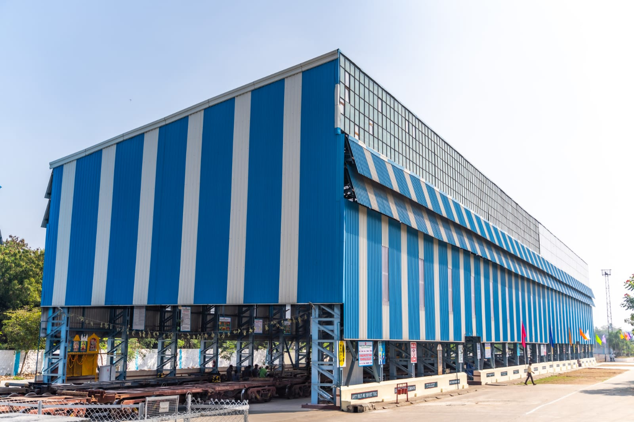
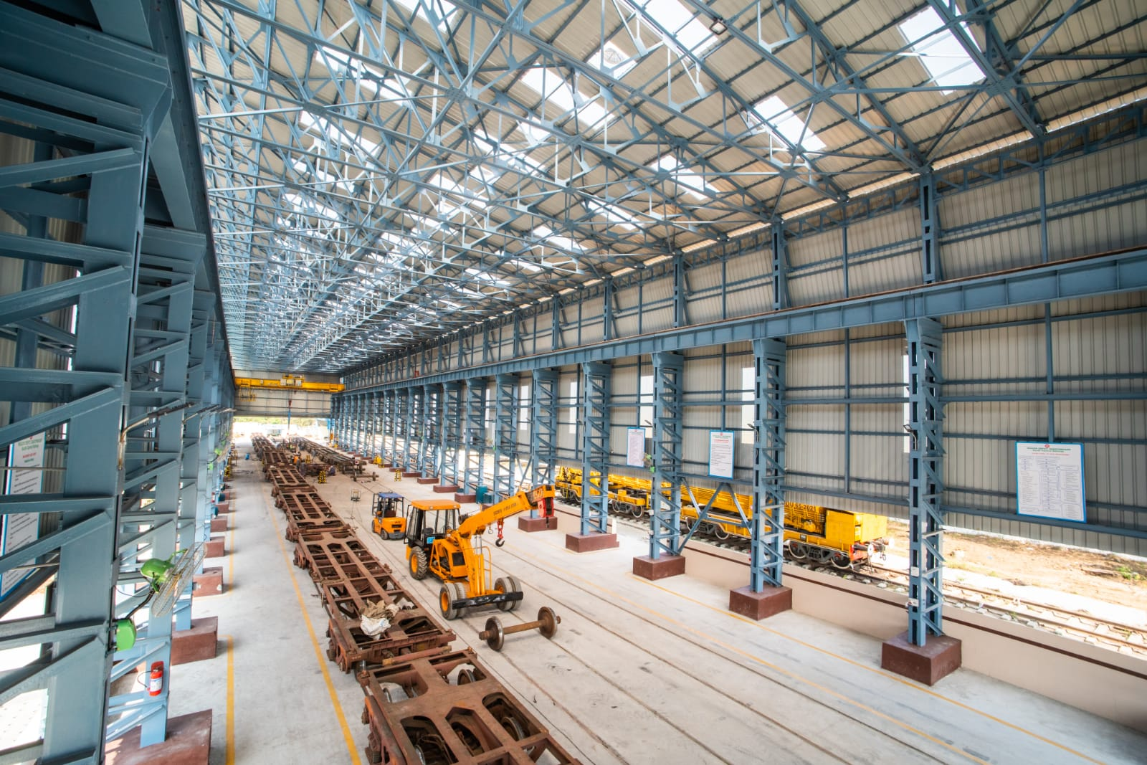
Classification of ROH Depots
S. No | Category | Targeted ROH/Month
1 | Super Depot | > 500 Wagons
2 | Mega Depot | 250 to 500 Wagons
3 | Major Depot | 125 to 250
4 | Minor Depot | Upto 125
ROH Shed
ROH Shed

Slide 41
THANKS

